Slide 1

Insurance Analytics
This presentation explores the key performance indicators (KPIs) and tools used in the insurance analytics field, highlighting the challenges faced and providing recommendations for effective data-driven decision making.
Presented By Group 2

Slide 2


Meet the Team
Rajat Kumar Maharana
Karishma Rahangdale
Shubham Satpute
Unnati Pujari
Mounika
Paidakula
Mithun S
Jogeswari Panigrahy

Slide 3
Insurance Analytics Overview
1
Risk Assessment
2
Customer Insights
Analyzing data to identify and mitigate potential risks.
Gaining a deeper understanding of policyholder behavior and preferences.
3
Operational Efficiency
4
Fraud Detection
Optimizing internal processes and workflows to improve productivity.
Leveraging data to identify and prevent fraudulent activities.

Slide 4
Key Performance Indicators (KPIs)
1
Cross sell
5
Yearly Meeting Count
Target, Achieve, New
2
New
6
Stage By Revenue
Target, Achieve, New
3
Renewal
7
No Of Meeting By Account Executive
Target, Achieve, New
4
No Of Invoice By Account Executive
8
Top Open Opportunity

Slide 5




Analytical Tools
Excel
SQL
Tableau
Power BI
Spreadsheet software for data analysis and reporting.
Structured Query Language for data extraction and manipulation.
Data visualization and business intelligence platform.
Self-service business analytics and reporting tool.

Slide 6
KPI Dashboard
Customer Acquisition Cost
Net Promoter Score
The cost of acquiring new customers, important for assessing marketing efficiency.
A measure of customer satisfaction and loyalty, indicating the likelihood of referrals.
Combined Ratio
Gross Written Premium
The sum of the loss ratio and expense ratio, a key indicator of underwriting profitability.
The total amount of premium income before deductions, a measure of business growth.

Slide 7
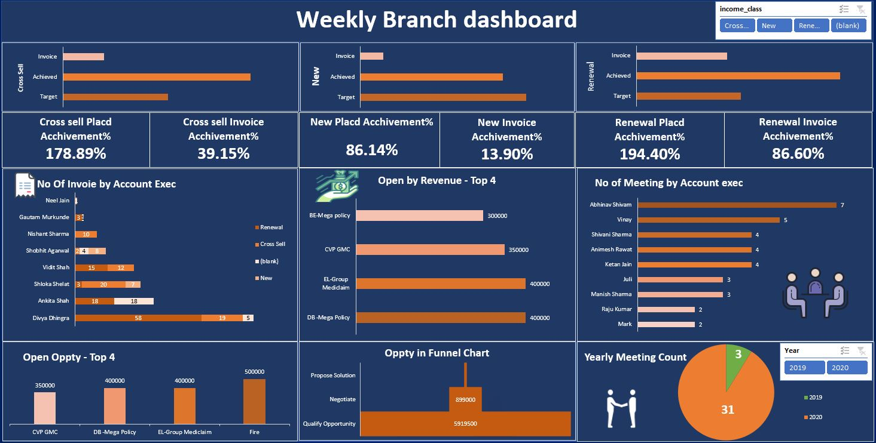
EXCEL FOR DATA VISUALIZATION

Slide 8
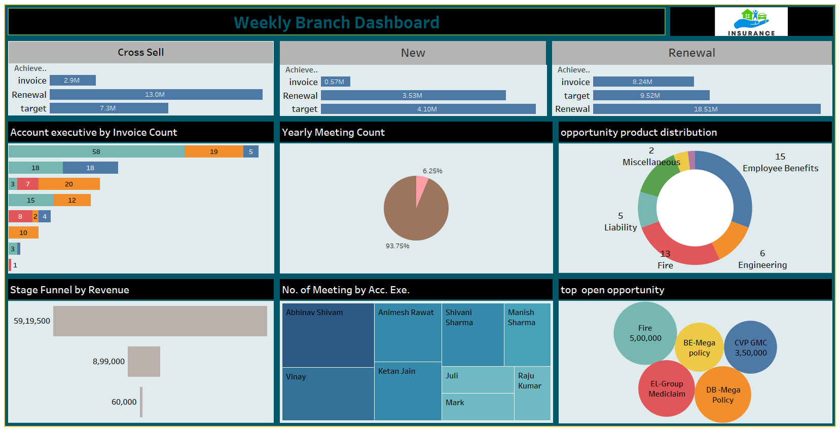
TABLEAU FOR DATA VISUALIZATION

Slide 9
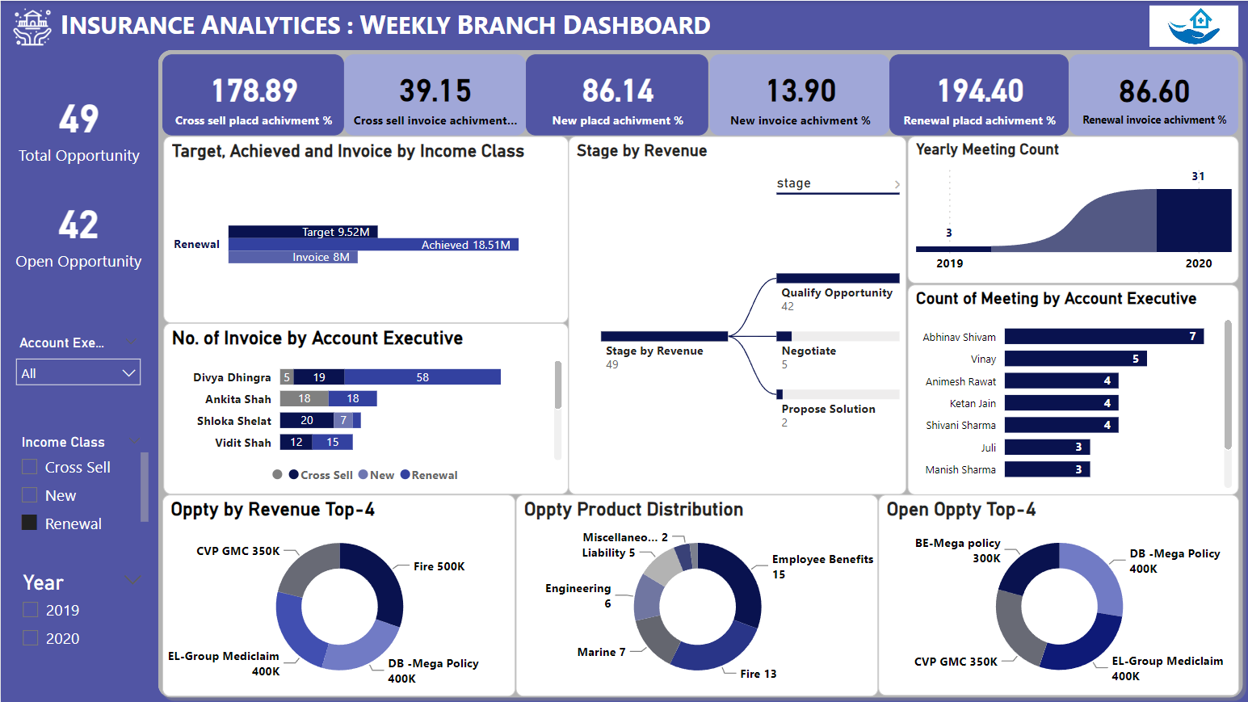
POWER BI FOR DATA VISUALIZATION

Slide 10





Challenges and Recommendations
Data Silos
Integrating data from multiple sources to create a comprehensive view.
Data Quality
Ensuring accuracy, completeness, and consistency of data for reliable analysis.
Regulatory Compliance
Adhering to industry regulations and data privacy policies.

Slide 11
Key Takeaways
Leveraging KPIs
Utilizing Analytics Tools
Overcoming Challenges
Identify and track the most relevant KPIs to drive data-driven decision making.
Maximize the potential of tools like Excel, SQL, Tableau, and Power BI for deeper insights.
Address data silos, quality issues, and regulatory constraints to unlock the full value of insurance analytics.

Slide 12


Thank You
For Your Attention
Connect Us Through
.

